Slide 1

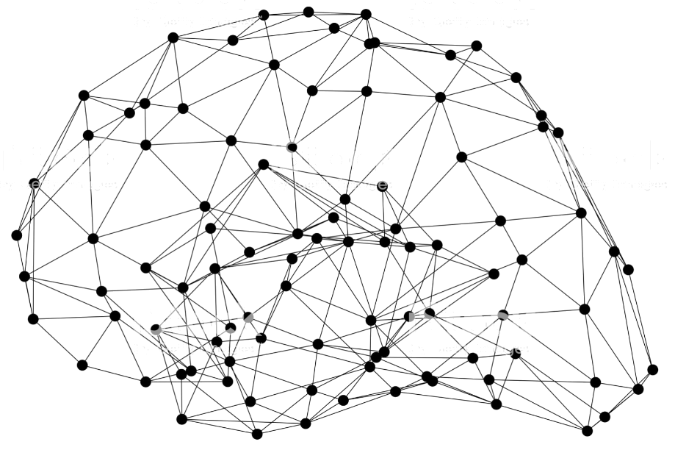
Deploy GluonCV models
Notes:
First call deck for a high level introduction to Apache MXNet.

Slide 2
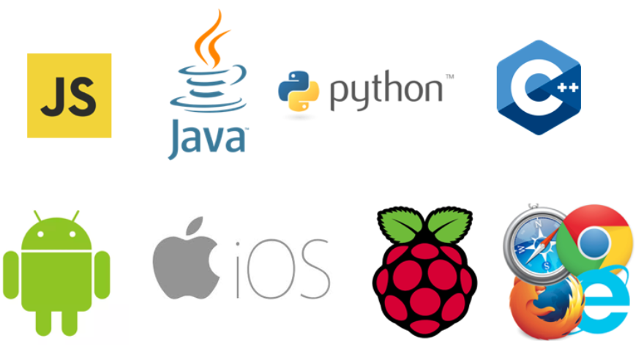
Models are not toys, they take effect after deployment
Notes:
Have you ever think about deploying your trained models to devices other than the GPU workstation? It’s sometimes more complicated than what you have expected.

Slide 3





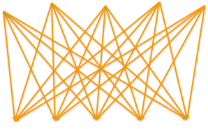

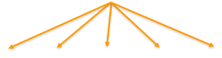

Deep learning inference is complicated
Before
After
Model framework
Model framework
Deep learning compiler
Target Device
Target Device
Notes:
Before we talk about deployment of CV models, let’s step back and look at the whole picture of the deep learning inference in general
And it is complicated. On one end, we have models trained using various frameworks, like mxnet, tensor flow , etc.
On the other end, we have many different target devices, such as cpu, gpu, embedded devices.
One approach to support all these pairs is to rely on 3rd party libraries. And if they don’t exist, or the performance is bad, then you’re out of luck.
Instead, another approach, we build our own deep learning compiler to solve this problem
Which you can convert models from different frameworks into a same infrastructure, and you can then apply optimization pass and target for various devices.

Slide 4
Models and hardware targets are far away!
Computation graph optimization
Tensor operation optimization
Machine code generation
Notes:
However, building such a deep learning compiler is not an easy job, especially if you want good performance.
It requires layers of optimization. On the high level, you needs graph optimization where you transform the computation graph to make it more effiecient
Second tensor operation optimization that optimizes the performance of each operator, and lastly you need to generate code for every targeted devices.

Slide 5

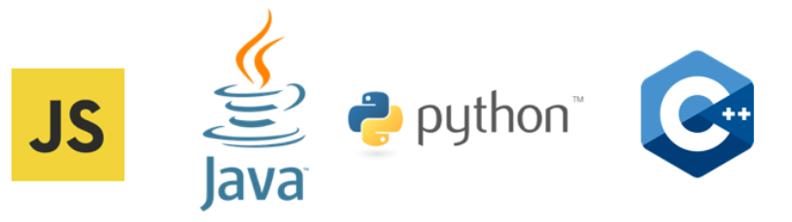
Deploy GluonCV Models
GluonCV Models
MXNet Computational Graph
Export As-is
Optimize with TVM
Json Acyclic Graph

Slide 6
Effects of Vision-specific Optimizations using TVM
AWS DeepLens
NVIDIA Jetson Nano
Acer aiSage

Slide 7
Effects of Convolution operators using TVM
AWS DeepLens
NVIDIA Jetson Nano
Acer aiSage

Slide 8
Hands On!

Slide 9
Like GluonCV? Go build!
https://github.com/dmlc/gluon-cv
https://gluon-cv.mxnet.io

